Slide 2
Dirac Equation
First accurate merging of quantum mechanics and special relativity was done by Dirac
Gave an equation for a free electron
Negative energy electrons (positrons)
Positive energy electrons (electrons)

Slide 3
Relativistic Two-Electron Integrals
Spinor symmetry
Basis functions
Function returning 2
integers
Large component
Small component

Slide 4
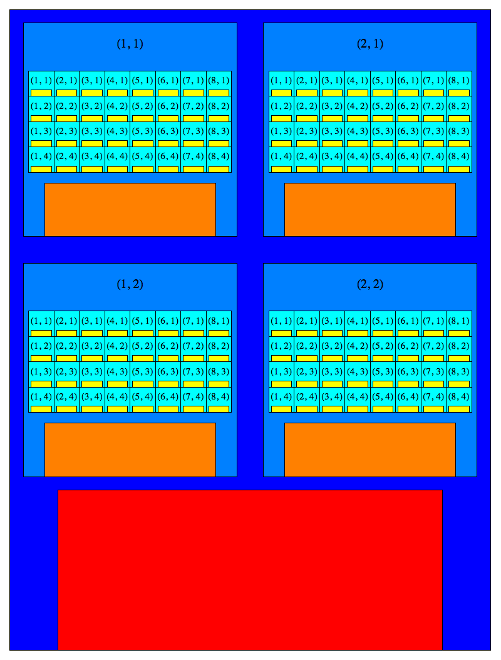
GPU Architecture: Threads, Warps, Blocks, and Grid
Thread: The simplest unit of computation in CUDA. Threads are what actually perform the instructions in the code.
Warp: A collection of 32 threads. All threads in a warp execute in lockstep. Not directly accessible in code, but it is fundamental to understand in order to maximize performance.
Block: A collection of an arbitrary number of threads. The exact number can be specified in code. Blocks can have up to three dimensions, which provide the threadIdx.x, threadIdx.y, threadIdx.z, blockDim.x, blockDim.y, and blockDim.z variables. The block in this image is a 8 x 4 block (one warp) of threads. A block can have 1024 threads at most.
Grid: A collection of an arbitrary number of blocks. The exact number can be specified in code. Grids can have up to three dimensions, which provide the blockIdx.x, blockIdx.y, blockIdx.z, gridDim.x, gridDim.y, and gridDim.z variables. The grid in this image is a 2 x 2 grid of blocks.

Slide 5
GPU Architecture: Streaming Multiprocessor Memory Resources
Streaming Multiprocessor (SM): Except for global memory, all GPU resources are local to a SM. The number of SMs per GPU depends on hardware generation. SMs can run at most 48 warps (1536 threads), or at most 8 blocks. Blocks cannot be divided between SMs.
Register Memory: Local to a specific thread. Fastest memory available, but also the least plentiful. The total amount of registers on an SM is shared equally across all threads running on the SM so the registers needed per thread contributes to the maximum number of threads that can run at once.
Shared emory: Local to a specific block. Slower than register memory, but more of it is available. The total amount of shared memory available is shared equally across all blocks running on the SM so the amount of shared memory needed per block contributes to the maximum number of threads that can run at once. Analogous to RAM in normal computing.

Slide 6
GPU Architecture: Global Memory
Global Memory: Available to all threads on a GPU. The slowest memory type available, but also the most plentiful. Analogous to hard drive space in normal computing. Data should be stored contiguously in order to minimize the performance hit from using it.

Slide 7
Matrix Multiplication Example
X
=
A
B
C
The matrices A, B, and C are stored in row-major order. So the rows of A and C can be read/written effectively. The columns of B cannot be read effectively.

Slide 8
Matrix Multiplication Example
Using a block size of 32x32 and a grid size of 2x2
Step 1: Map threads to elements of matrix C
Step 2: Copy the first tiles of matrix A and B into the shared memory
Step 3: Each thread independently multiplies the needed elements of A and B and stores the result in the register memory
Step 4: Copy next set of tiles into the shared memory and repeat step 3
Step 4: Copy result from the shared memory to the global memory
Global Memory
Shared Memory
Register Memory

Slide 9
Two-Electron Algorithm
Six indices to loop over and a non-trivial method of
determining their maximum values makes this algorithm difficult to parallelize

Slide 10
Three-Dimensional Solution
Map λ to threadIdx.x, p to threadIdx.y and q to threadIdx.z
Block dimensions would be (1, 32, 32) and the grid would have
dimensions of

Slide 11
Three-Dimensional Solution
Basis set of size (30,25,25,20,20,15,15).
The blockDim = (1,32,32) and gridDim = (7,1,1)
Workload is not distributed to threads very well.

Slide 12
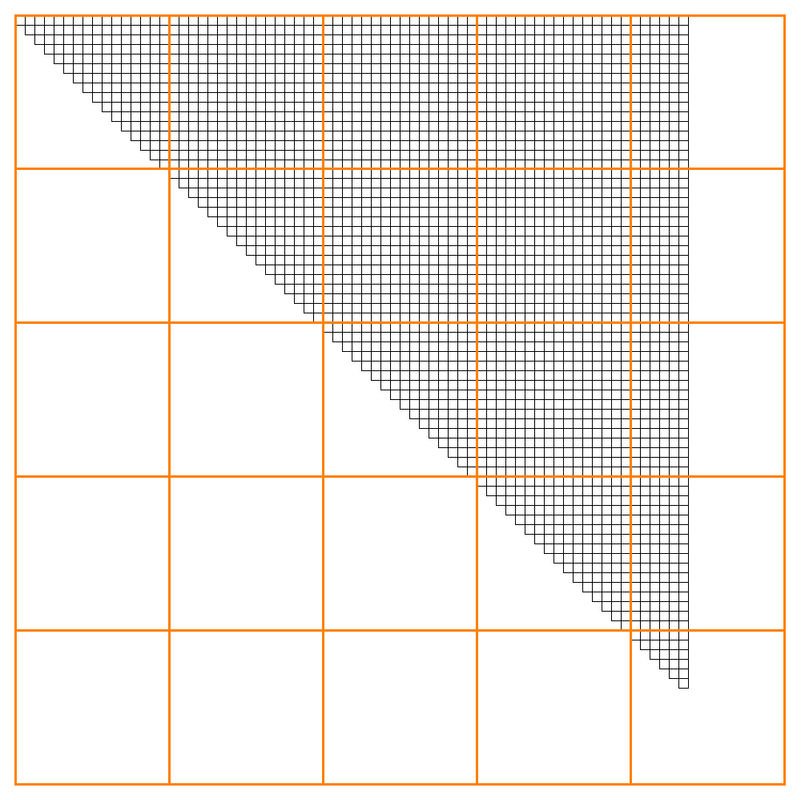
Two-Dimensional Solution
Better because each thread is now only calculating
one set of integrals
Still have issues with blocks containing idle threads

Slide 13

One-Dimensional Solution
Best solution because all threads have the same work load
and only the last block has the possibility of having idle threads

Slide 14
Mapping Threads
Basis set of size (3, 2, 2)

Slide 15
Mapping Thread

